Slide 1

COMP 484 Web Engineering I
Instructor: ~kaplan (akaplan@csun.edu)
Supplemental Slides: Cascading Style Sheets (CSS)
part 1
Notes:
Traceroute

Slide 2
Cascading Style Sheets
Used to specify the presentation of elements
Was once the job of HTML
New separation…
HTML = content and structure of document
Section headers, body text, links…
CSS = presentation / appearance
Fonts, spacing, sizes, colors, positioning
Latest version CSS3
We’ll be covering the newer features last
CSS validator
http://jigsaw.w3.org/css-validator/
This tool can help you make sure that your code is correct and will work on CSS3-compliant browsers
© 2008 Pearson Education, Inc. All rights reserved.

Slide 3
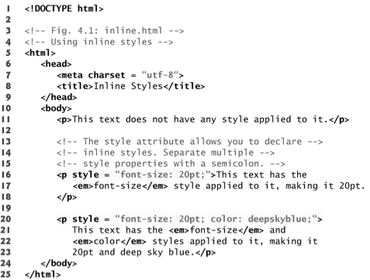
Inline Styles
Style attribute
Apply CSS properties to the HTML element
Property name is followed by a colon and the value of the attribute
Multiple property declarations are separated by a semicolon
In HTML5, can be used on any HTML element
Not necessarily useful
© 2008 Pearson Education, Inc. All rights reserved.
Notes:
Note: inline styles do not truly separate presentation from content.
Also, it would be nice to apply similar styles to multiple elements without redundant code.

Slide 4
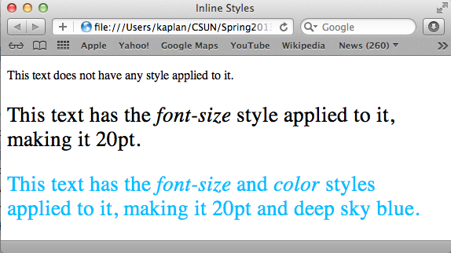
Inline Styles (cont)
Style attribute
Sets paragraph’s font size to 20
Sets color to deepskyblue
© 2008 Pearson Education, Inc. All rights reserved.
Notes:
More detail
On line 20 we see a style attribute, and that is applying style to this paragraph, with font-size 20 pt and font color deepskyblue
There is another paragraph with style applied to it, on line 16. This paragraph only has font-size 20 pt.
Note for now that when using inline style, I must copy and paste a specific style to each such HTML element, even if I want to give several elements the same style
Or give an entire element type that style
This motivates the concept of a CSS selector, which I will discuss soon.
Please note, finally that the paragraph on line 11 has no style applied to it. For most browsers, the default font is black text, 12 pt font, and serif.

Slide 5
Hexadecimal Color Codes
RGB Values
Each byte is a hex number
Specifies how much red, green, and blue in color
Byte value in the range of 00 - FF
In decimal, this is 0 through 255
First byte is red, second byte is green, third byte is blue
So, for example, #FF00FF has
Red: 255
Green: 0
Blue: 255
Combined, this makes fuchsia
© 2008 Pearson Education, Inc. All rights reserved.
Notes:
RGB Color Mode
RGB is the color scheme that is associated with electronic displays, such as CRT, LCD monitors, digital cameras and scanners. It is an additive type of color mode, that combines the primary colors, red, green and blue, in various degrees to create a variety of different colors. When all three of the colors are combined and displayed to their full extent, the result is a pure white. When all three colors are combined to the lowest degree, or value, the result is black. Software such as photo editing programs use the RGB color mode because it offers the widest range of colors.
CMYK Color Mode
Printers print color onto paper using the CMYK color mode only. This is a four color mode that utilizes the colors cyan, magenta, yellow and black in various amounts to create all of the necessary colors when printing images. It is a subtractive process, which means that each additional unique color means more light is removed, or absorbed, to create colors. When the first three colors are added together, the result is not pure black, but rather a very dark brown. The K color, or black, is used to completely remove light from the printed picture, which is why the eye perceives the color as black.

Slide 6
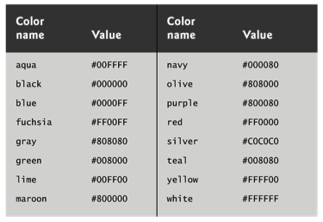
color Property
Sets text color
Color names and hexadecimal codes may be used as value
Complete list of HTML standard and extended colors at
www.w3.org/TR/css3-color/
Standard HTML Color Names and Hex Values
© 2008 Pearson Education, Inc. All rights reserved.

Slide 7
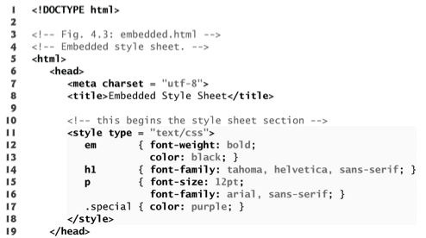
Embedded Style Sheets
Style sheet begins
Sets MIME type to text/css
Sets properties for all em elements in document
Sets properties for all h1 elements in document
Sets properties for all p elements in document
Creates a special class
Style sheet ends
© 2008 Pearson Education, Inc. All rights reserved.
Notes:
Stylesheets can be embedded within the head section of an HTML document
We call these “embedded style sheets”
Body of style sheet declares CSS rules
Each rule specifies elements that will be styled according to rule (called the __CSS selector__…example “em” on first rule)
Each rules body enclosed in curly braces…uses same syntax as inline styles
Their MIME( Multipurpose Internet Mail Extensions) type is always text/css
- MIME types identify non-ASCII parts of email message, usually attachments
- use has expanded to HTML
- 2 part identifier, type and subtype
- Common MIME types include:
- text/css
- image/png
- text/javascript
- text/plain
- image/jpeg
- text/html
Style-class declarations (like “special” in this stylesheet)
- preceded by a “.”
- applied to elements of the specific class (using the class attribute in HTML)

Slide 8
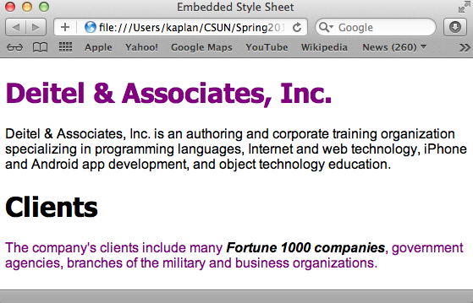
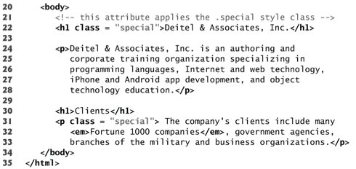
© 2008 Pearson Education, Inc. All rights reserved.
Notes:
Here we see use of the class element on both a header and a paragraph
Remember the special class set “color: purple”
And on <em> tags we have “font-weight: bold; color: black”
Notice on <h1> tags we have “font-family: tahoma, helvetica, sans-serif;”
Notice on <p> tags we have “font-size: 12 pt; font-family: arial, sans-serif;”

Slide 9
Correction on Slide 7:
MIME ( Multipurpose Internet Mail Extensions )
In the narration, I mis-spoke and said “Multipart”

Slide 10
CSS font-weight property
Specifies the “boldness” of text
Possible values are…
bold
normal (the default)
bolder (bolder than bold text)
lighter (lighter than normal text)
Boldness also can be specified with multiples of 100, from 100 to 900 (e.g., 100, 200, …, 900)
Text specified as normal is equivalent to 400, and bold text is equivalent to 700
Example: {font-weight: 700; …}
© 2008 Pearson Education, Inc. All rights reserved.

Slide 11
CSS font-family property
Specifies the name of the font to use
Generic font families allow authors to specify a type of font instead of a specific font
In case a browser does not support a specific font
Example:
{font-family: tahoma, helvetica, sans-serif; …}
Start with the font you want (tahoma)
Next list fallbacks, in case the browser doesn’t have that font (helvetica is a fallback)
Finally, name a generic family so browser can pick any such font available if none of preferences are present (sans-serif)
© 2008 Pearson Education, Inc. All rights reserved.
Notes:
Serif are small lines tailing from edges of letters and symbols (tiny flourishes)
(family, fonts) as follows…
serif fonts include times new roman, georgia
sans-serif fonts include arial, verdana, futura
cursive fonts include scripts
fantasy fonts include critter
monospace fonts include courier and fixedsys

Slide 12
CSS font-size property
Specifies the size used to render a font
Can specify point size or relative value
Relative values: xx-small, x-small, small, smaller, medium, large, larger, x-large, and xx-large
Relative values preferred over points, as client displays tend to vary in exact size
Examples:
{font-size: 12pt; …}
{font-size: xx-small; …}
© 2008 Pearson Education, Inc. All rights reserved.
Notes:
Note…users may change the font sizes their browser displays for readability, so relative values are more flexible

Slide 13
Style Classes and id Selectors
Style Classes
Style-class declarations are preceded by a period (.)
Define styles that can be applied to any element
In prior example, class special sets color to purple
In many cases, styles applied to an element also apply to the element’s nested elements
Multiple values of one property can be set or inherited on an element
Browser must reduce these to one value
ID Selectors
For any HTML element in page with an id
Can declare a selector of the form #elementId to
specify that element’s style
© 2008 Pearson Education, Inc. All rights reserved.
Notes:
We’ll talk about that reduction soon…

Slide 14
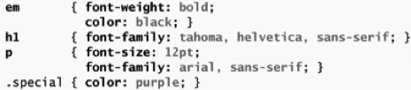
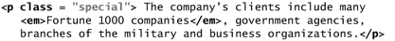
Conflicting Styles - Example
© 2008 Pearson Education, Inc. All rights reserved.
Styles cascade, or flow together, such that the ultimate appearance of elements results from combining styles
Properties defined for child/descendant elements have a higher specificity than properties defined for parent and ancestor elements
Conflicts are resolved in favor of properties with a higher specificity, so the child’s styles take precedence
Notes:
child em element inherits the font-size property from its parent p element.
child em element has a color property that conflicts with (i.e., has a different value than) the color property of its parent p element

Slide 15
CSS Specificity Rules
IDs are the most specific
Refer to only one element in the DOM
Classes are more specific than HTML selectors
Example: .special is a more specific selector than em
Nested HTML selectors are more specific than general HTML selectors
Example: p em is a more specific selector than em
Rules for DOM children/descendents are more specific than those inherited from parents/ancestors
Later rules are more specific than earlier rules
The universal selector (*) is the least specific

Slide 16
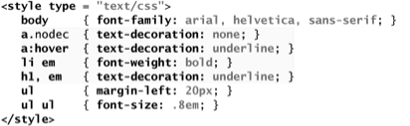
Defines the class nodec which can only be used by anchor elements
Sets properties for the hover pseudoclass of anchor elements, activated when user moves cursor over anchor
All em elements which are descendents of li have their font bolded
All h1 and em elements are underlined
© 2008 Pearson Education, Inc. All rights reserved.
Notes:
text-decoration property applies decorations to text in an element
underline
overline
line-through
Blink
To apply rules to multiple elements, separate them with a comma
To apply rules to a certain type of element that is child of another type, separate them with spaces
Pseudoclasses are a way to add special effects to some selectors
hover pseudoclass is activated when the user moves the mouse cursor over an element
Note: including a space before or after the colon separating pseudo-class from the name of the element to which it’s applied prevents it from being applied properly
Pseudoclasses
- first-letter = first letter of element
- first-line = first line of element
- first-child = accesses first child of element
- before = insert content before element
- after = insert content after element
- lang = different rules for different languages
- hover = mouse-over
- link = unvisited links
- visited = visited links
- active = active link
- focus = input element which has focus

Slide 17
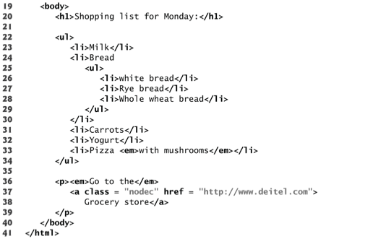
© 2008 Pearson Education, Inc. All rights reserved.

Slide 18
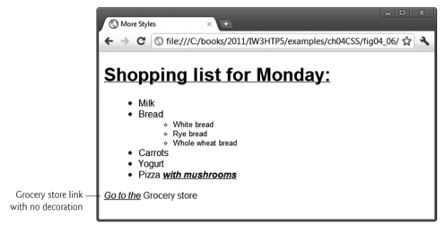
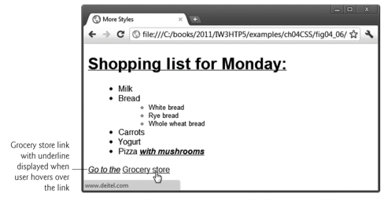
© 2008 Pearson Education, Inc. All rights reserved.
Notes:
All h1 and em are underlined
Em inside li are bolded
Grocery store link has no decoration
When hovered over, grocery store link is underlined

Slide 19
Relative Lengths vs Absolute Lengths
Relative length measurements:
px (pixels – size varies depending on screen resolution)
em (usually the height of a font’s uppercase M)
ex (usually the height of a font’s lowercase x)
Percentages (of the font’s default size)
Absolute-length measurements
(i.e. units that do not vary in size)…
in (inches)
cm (centimeters)
mm (millimeters)
pt (points; 1 pt = 1/72 in)
pc (picas; 1 pc = 12 pt)
© 2008 Pearson Education, Inc. All rights reserved.
Notes:
{font-size: 200%}

Slide 20
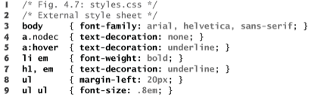
Linking External Style Sheets
External style sheets are separate documents that contain only CSS rules
Help create a uniform look for a website
Separate pages can all use the same styles
Modifying a single style-sheet file makes changes to styles across an entire website
This concept is sometimes known as skinning
© 2008 Pearson Education, Inc. All rights reserved.
Notes:
CSS comments may be placed in any type of CSS code (i.e., inline styles, embedded style sheets and external style sheets) and always start with /* and end with */.

Slide 21
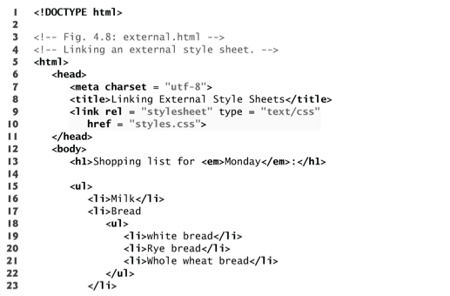
link element
Uses rel attribute to specify a relationship between documents
This rel declares linked document to be stylesheet for this document
type attribute
MIME type of linked document (“text/css”)
href attribute
URL for document containing stylesheet
© 2008 Pearson Education, Inc. All rights reserved.
Notes:
This example HTML5 references the external style sheet.
link element
Uses rel attribute to specify a relationship between two documents
rel attribute declares the linked document to be a stylesheet for the document
type attribute specifies the MIME type of the related document
href attribute provides the URL for the document containing the style sheet

Slide 22
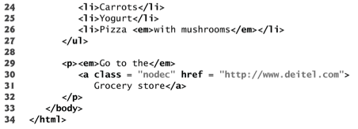
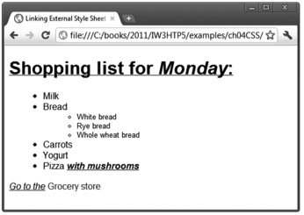
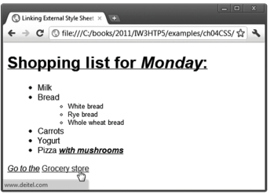
© 2008 Pearson Education, Inc. All rights reserved.

Slide 23
HTML Text Flow
Text flow: positioning of HTML elements one after the other when the page is rendered
Two kinds of elements that contribute to text flow…
Block-Level Elements
Displayed on their own line
Rendered with a virtual box around them
Examples…
Paragraphs <p>
Headings <h1>-<h6>
Lists <ol><ul>
Tables <table>
Division <div>
Examples…
Anchors <a>
Images <img>
Emphasis <em>
Strong <strong>
Span <span>
Inline Elements
Render next to surrounding elements in the same line
Unless a natural line break must occur
Do not break “the flow”
© 2008 Pearson Education, Inc. All rights reserved.
Notes:
A bit of HTML history
Originally everything was part of a flow except table cells, which were the only handy way of arranging element positions for block layout
Complicated nesting of tables for professional page layouts
Every table cell has an internal flow

Slide 24
Span and Div Elements
span
Inline grouping element
Does not apply any formatting to its contents
Creates a container for CSS rules or id attributes to be applied to a section of text
Does not change the flow of elements in the document
div
Block-level grouping element
Like a span but its content is on separate lines than content before/after the div
Separated from rest of document like a paragraph <p>
Has a virtual box drawn around it (uses the box model)
© 2008 Pearson Education, Inc. All rights reserved.
Notes:
Div is also a grouping element, but it’s a block-level element
Inline Elements
* do not change flow of elements in a document
* span, img, a, em, and strong
Block-level elements
Displayed on their own line
Have virtual boxes around them
Examples:
p
all headings (h1 through h6)
div
A grouping element like span

Slide 25
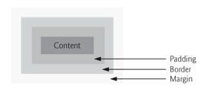
© 2008 Pearson Education, Inc. All rights reserved.
Block-Level Elements: Box Model
Block-level elements are rendered using the box model
The content is surrounded by padding, a margin and a border
Padding
Distance between the content inside an element and the edge of the element
Margin
Distance between the element’s edge and any outside text

Slide 26
Block-Level Virtual Box Properties
Padding properties
padding-top, padding-right, padding-left and padding-bottom
Margin properties
Can set margin-top, margin-right, margin-left and margin-bottom
Border properties
border-width
thin, medium or thick, or any CSS length
border-color
Color used for the border
border-style
Options: none, hidden, dotted, dashed, solid, double, groove, ridge, inset and outset
© 2008 Pearson Education, Inc. All rights reserved.

Slide 27
Display: Inline vs Block vs Inline-Block
Can force a block-level HTML element to display inline or vice versa using CSS…
display: inline
display: block
Inline-block
display: inline-block
Newer CSS construct
Element behaves as a block element…
On the element itself, can set width/height, margins, padding, etc
…but placed inline, next to other elements

Slide 28
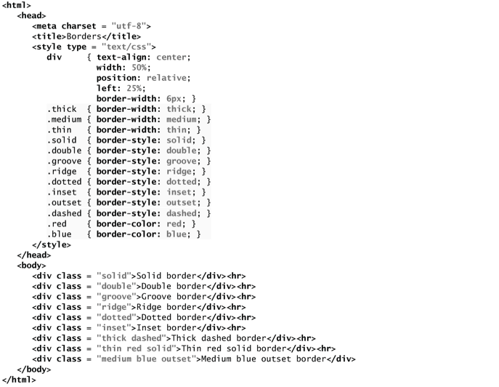
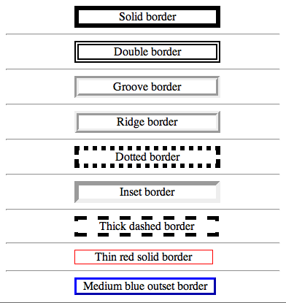
Note: can apply several classes to same element, space separated
© 2008 Pearson Education, Inc. All rights reserved.
Notes:
HR = horizontal rule… a marker for a thematic break

